Slide 1
Recurrent Neural Network

Slide 2
Application of sequence models
Speech recognition
Music generation
Sentiment classification
DNA sequence analysis
Machine translation
Video activity recognition

Slide 3
Why not ANN
Input, output different in lengths in different samples
Does not share features learnt at different position

Slide 4

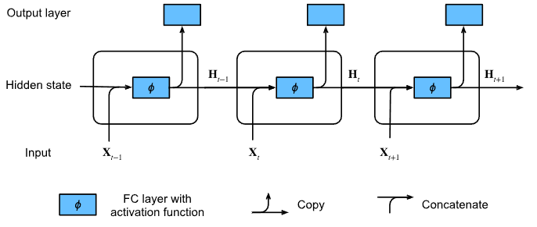

Forward path

Slide 5

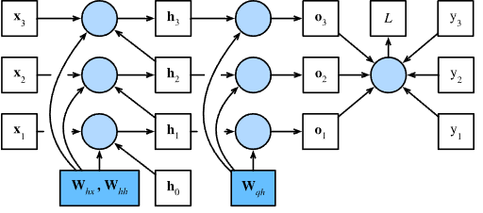

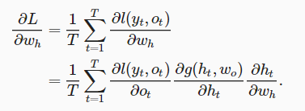
BPTT
Notes:
https://mmuratarat.github.io/2019-02-07/bptt-of-rnn
https://www.geeksforgeeks.org/ml-back-propagation-through-time/

Slide 6
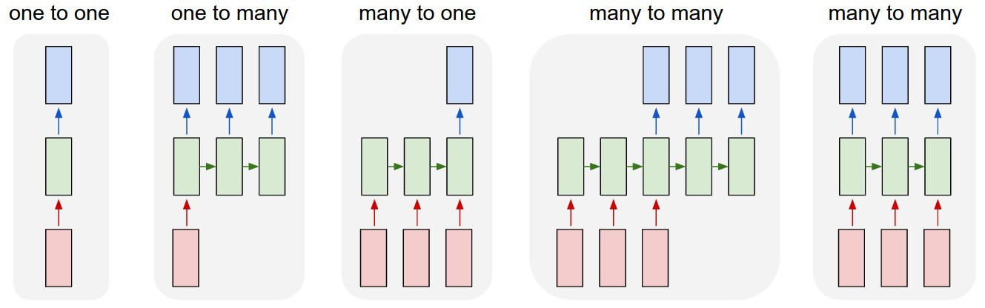
RNN

Slide 7
Vanishing gradient

Slide 8
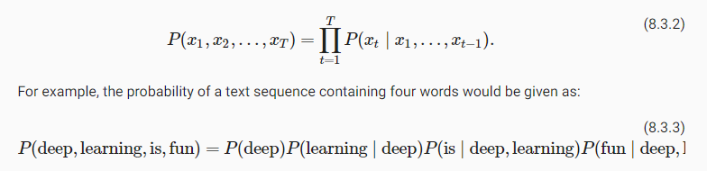

Language model
Imagine that we have, for example, a model of a physical world. What do you expect it to be able to do? It probably can predict what happens next given some description of "context"
Notes:
https://lena-voita.github.io/nlp_course/language_modeling.html

Slide 9
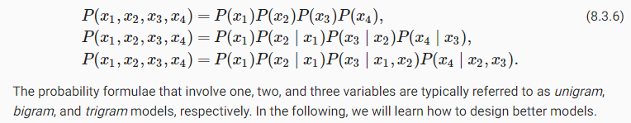
Language model n-gram

Slide 10
Language model example
Tokenization: text sequence to list of tokens (code)
Vocabulary: map string tokens into numerical indices starting from 0 (code)

